Slide 1
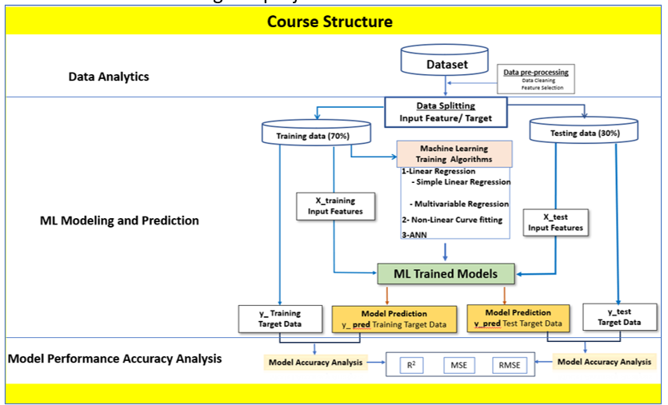
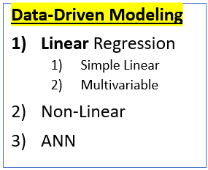
Group Work Data-Driven Modelling! Application of the workflow for your Project
Project 1
Data Pre-processing
Data-Driven Modeling
Linear Regression
Simple Linear
Multivariable
Non-Linear
ANN
Project 2,3,4

Slide 2
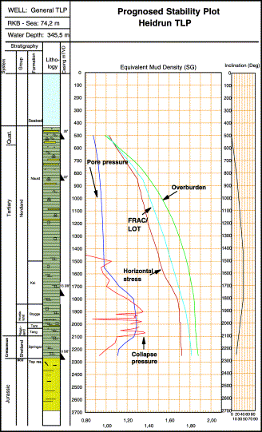
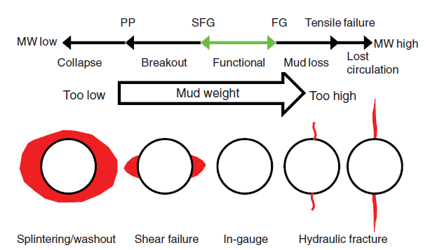
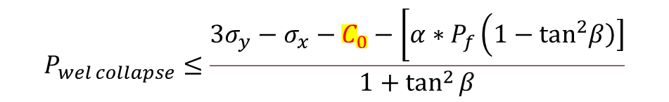
1 Introduction
Wellbore Stability:
The well pressure should be between:
Fracture gradient
Well collapse Gradient
Well collapse model:
$$P_{wel collapse}≤\frac{3σ_{y}−σ_{x}−C_{0}−\left[α∗P_{f}\left(1−\tan^{2}\left.\left.β\right)\right]\right.\right.}{1+\tan^{2}{β}}$$
Fjær, et al (2008)

Slide 3
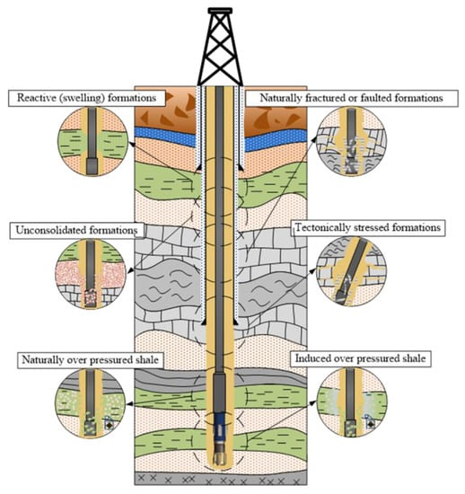
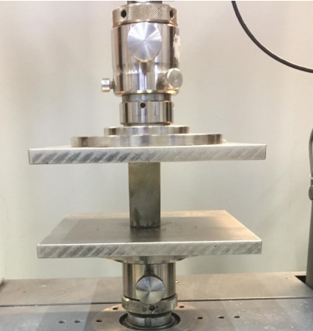
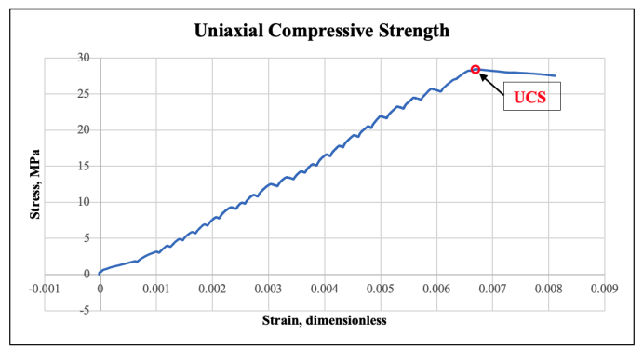
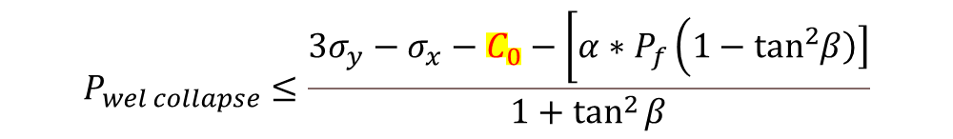
2 What is the problem with collapse model calculation? Determination of Co (UCS) as a profile in the well
Fjær, et al (2008)
$$P_{wel collapse}≤\frac{3σ_{y}−σ_{x}−C_{0}−\left[α∗P_{f}\left(1−\tan^{2}\left.\left.β\right)\right]\right.\right.}{1+\tan^{2}{β}}$$

Slide 4
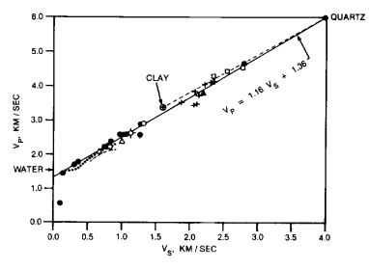
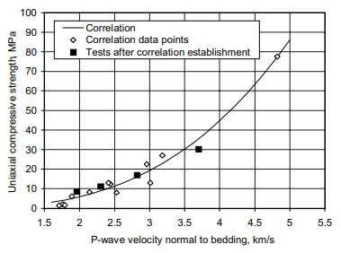
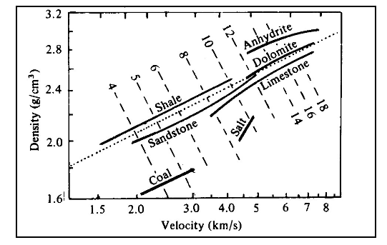






3 What is the Solution for UCS estimation?
$$P_{wel collapse}≤\frac{3σ_{y}−σ_{x}−C_{0}−\left[α∗P_{f}\left(1−\tan^{2}\left.\left.β\right)\right]\right.\right.}{1+\tan^{2}{β}}$$
To solve the issue of continuously estimating UCS in the drilling depth, it is common practice to estimate rock strength based on wireline logs that continuously measure the formation responses.
Several investigators have shown the relationship between different logs. It means that they develop machine learning-based empirical models that estimate one parameter based on the other measured parameter. The following presents two examples along with a solution for UCS.
Gardner et al. (1974)
$$ρ= α∗v_{p}^{β}$$
$$ρ is DEN$$
Castagna et al. (1985)
(Horsrud 2001)
$$V_{p}\left(\frac{km}{s}\right)=0.0003048{\left(\frac{DEN}{0.23}\right)}^{4}$$
$$v_{p}=1,16∗v_{s}+1,36$$
$$C_{0}={0,77∗v}_{p}^{2,93}$$

Slide 5
4 The Project!
In this group project, you will develop a new ML model based on the three ML training algorithms that estimate Vp from other log datasets (DEN, NEU, Vs) . You will also compare your model estimated with the literature models (Gardner et al. and Castagana et al.).
You NEED to implement the workflow during the project work!

Slide 6
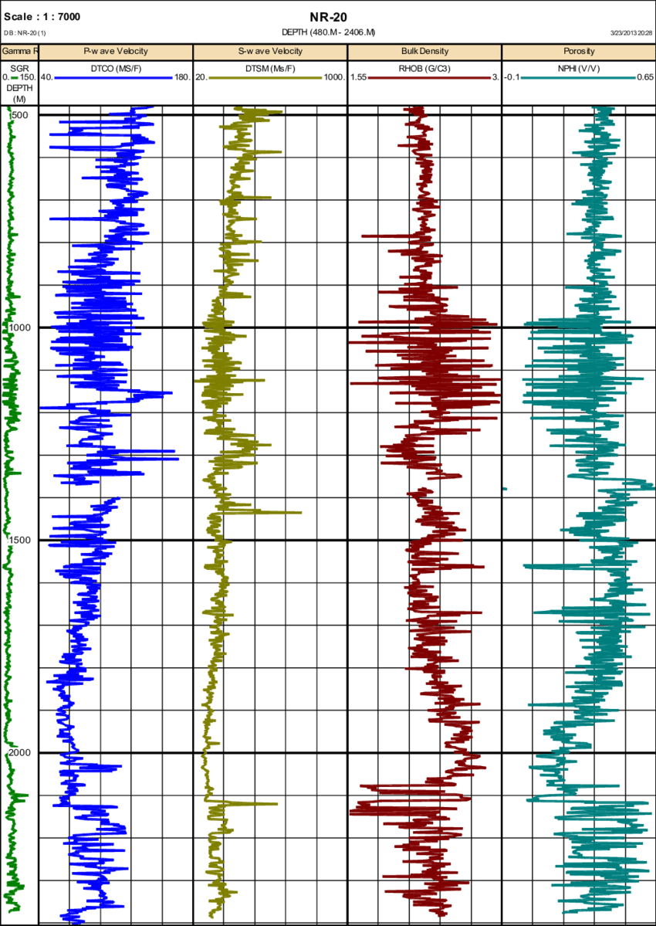

Slide 7
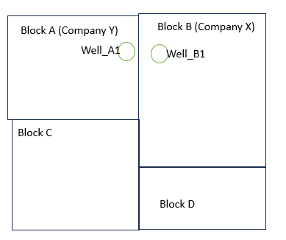
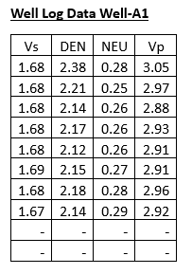
4.1 Project Tasks!
Your company X is planning to drill a new well in Block B and the well will be called Well B1.
Your boss asked you to design a wellbore stability design. Since the in-situ stresses are available, estimating the well fracturing profile is easy.
But, for the well collapse, the Uniaxial compressive Strength of the formation to be drilling data is not available. Since well B1 is the first well in block B, there was no measured log data available.
However, as shown in Block A, Well_A1 has been drilled by Company Y. Since the Well_A1 and Well_B1 are very close, it is assumed that the lateral geologies of the formations are similar.
Therefore, Company X managed to get the log data of Well_ A1 as provided in the table.

Slide 8





4.2 What to do?
1: Use Vp as the true data and compute UCS (Co) from Vp.
The result is considered as True UCS so that the result will be compared with Vp models that will be estimated from other logs trained by different ML algorithms.
2: What if we don’t have measured Vp, can we estimate Vp from other logs?
1) Use Linear and Multivariable Regression to model (DEN, NEU, Vs) vs Vp
2) Use Non-Linear regression algorithms to model (DEN, NEU, Vs) vs Vp
3) Use ANN to model (DEN, NEU, Vs) vs Vp
3) Compare your model Vp prediction with the literature models
Gardner (1974)
Castagna (1985)
(Horsrud 2001)
$$C_{0}[MPa]={0,77∗v}_{p}^{2,93}$$
$$V_{p}\left(\frac{km}{s}\right)=0.0003048{\left(\frac{ρ\left(\frac{g}{cc}\right)}{0.23}\right)}^{4}$$
$$ρ= α∗v_{p}^{β}$$
$$ρ is DEN$$
$$v_{p}=1,16∗v_{s}+1,36$$

Slide 9
4.3 Result Guide and Projects
To answer the research question, you need to apply the workflow
Data Cleaning (Project 3 –Task #1)
Modeling: Apply the three ML algorithm to create ML-based models such as:
Linear and Multivariable regression Modeling (Project 3 –Task #2)
Simple linear regression: Vp = a* (vs, or Den, or NEU) + b
Multivariable regression: Vp = a+ b* vs+ c*Den+ d*NEU or a combination of two logs.
Non-Linear curve fitting ( Power, Exponential, Log (ln), Polynomial ……) Modeling (Project 3 –Task #3)
ANN ML modeling Vp is the target and Input Features are vs, Den, and NEU. (Project 3 –Task #4)
Model Performance Accuracy Analysis [Apply for (Task 2), (Task 3) and (Task 4)]
Select one best model from each algorithm.
Compute UCS-based Vp, and Model predicted Vp
Generate R2 for each model.
Finally, select the best
Plot USC (Vp) with UCS (Vp model)
List down in the order of best model…from each model….
++ other important information you obtained from the work!

Slide 10
References
1. Lecture notes and project descriptions: MOD300 Applied Computational Modelling, University of Stavanger, 2024
2. Fjær, E., Holt, R. M., Raaen, A., & Horsrud, P. (2008). Petroleum related rock mechanics. Elsevier. 2nd Edition, Volume 53 - January 4, 2008
3. Gardner, G.H.F.; Gardner L.W.; Gregory A.R. (1974). Formation velocity and density -- the diagnostic basics for stratigraphic traps (PDF). Geophysics. 39: 770–780. 1974
4. Castagna, J.P., Batzle, M.L., and Eastwood, R.L., (1985), Relationships between compressional-wave and shear-wave velocities in clastic silicate rocks: Geophysics, 50, 571-581 4.
5. Per Horsrud, Estimating Mechanical Properties of Shale From Empirical Correlations, June 2001 SPE Drilling & Completion

Slide 11
5 Pieces of Advice!
Use each lecture and laboratory training code to do the assignment.
You can contact me anytime about the project clarification….
Try to show your creative way of working!

